Slide 1
Machine Learning Models: a hands-on experience
Link to notebooks
UniCredit Quant Community
Gabriele Bonomi Boseggia, Fabio Colombo, Luca Mammi
Milan, May 8th, 2018

Slide 2
Why do we need Machine Learning?
Every decisional process we observe is the outcome of a judgmental process
Sometimes it is useful to automatize such processes, to support human decision
Take an umbrella while leaving for work
Ok, maybe not!
€
Grant a loan to someone
Grant loans to 1 million candidates
Apply a commercial offer to a client
Associate similar offers to similar clients
Extract the main message of written text
Identify spam
Identify contents of a picture
Identify diseases in a million CAT scans

Slide 3
What is Machine Learning used for?
https://hbr.org/2016/05/when-to-trust-robots-with-decisions-and-when-not-to

Slide 4
What is Machine Learning?
Machine Learning is a set of tools that use information to enable the automation of decision making
Training Data
Machine Learning Algorithm
New Data
Trained Model
Prediction
Prescriptive Analytics
Machine learning
Decision making

Slide 5
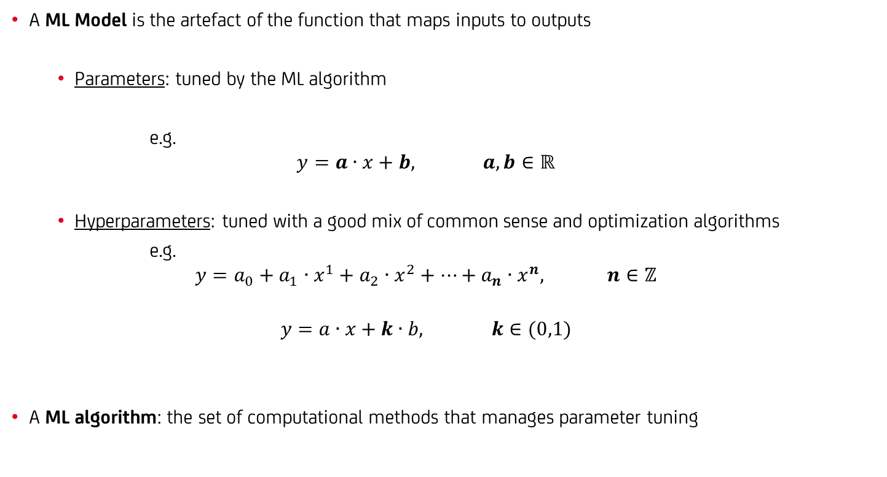
What is Machine Learning?
A ML Model is the artefact of the function that maps inputs to outputs
Parameters: tuned by the ML algorithm
e.g.
$$y=a∙x+b, a,b∈ℝ$$
Hyperparameters: tuned with a good mix of common sense and optimization algorithms
e.g.
$$y=a_{0}+a_{1}∙x^{1}+a_{2}∙x^{2}+…+a_{n}∙x^{n}, n∈ℤ$$
$$y=a∙x+k∙b, k∈(0,1)$$
A ML algorithm: the set of computational methods that manages parameter tuning

Slide 6
Types of Machine Learning – by how they work
Labelled data
Unlabelled data
Environment model
Supervised learning
Unsupervised learning
Reinforcement learning
Classification
Clustering
Regression
Dimensionality reduction
…but is this the most
effective taxonomy?

Slide 7
Types of Machine Learning – by what we need them to do
we will focus on classification
http://scikit-learn.org/stable/tutorial/machine_learning_map/index.html

Slide 8
Machine Learning is nothing new, why the hype?
A.M. Legendre: least squares method
Google Brain: NN to recognize cats in videos
IBM: programs that play checkers
Facebook: DeepFace to recognize faces
F. Rosenblatt: the perceptron
Google: Sibyl to predict user behavior
T. Cover, P. Hart: k-NN
Google: AlphaGo beats humans at Go
S. Linnainmaa: automatic differentiation
Stanford University: a cart that can navigate and avoid obstacles in a room
K. Fukushima - the neocognitron
D. Rumelhart, G. Hinton, R.J. Williams: backpropagation
C. Watkins - Q-learning for reinforcement learning
G. Tesauro: machine playing backgammon
T.K. Ho: random decision forests
C. Cortes, V. Vapnik: SVM
S. Hochreiter, J. Schmidhuber: LSTM for recurrent NNs
IBM: machine beats chess world champion Kasparov
Netflix Prize competition launched (won in 2009)
IBM: programs that play checkers
Kaggle is born
G. Hinton: capsule networks
1805
1952
1957
1967
1970
1979
1980
1986
1989
1992
1995
1997
2006
2010
2011
2012
2014
2016
2017
https://en.wikipedia.org/wiki/Timeline_of_machine_learning

Slide 9
What do you need for Machine Learning?
Link to tidyverse and caret notebook
Link to caret and tidyverse cheatsheets
You just need the right R packages!
tidyverse (developed by Hadley Wickham, Chief Scientist at Rstudio)
"a set of packages that work in harmony because they share common data representations and API design"
including dplyr, ggplot2, magrittr
caret (Classification And REgression Training)
"a set of functions that attempt to streamline the process for creating predictive models"
calls packages such as e1071, keras, mlbench, randomForest
https://cran.r-project.org/package=tidyverse, Wickham, Hadley (2017). "R for data science"
https://cran.r-project.org/package=caret

Slide 10
Machine Learning models: linear and logistic regressions
You might already know…
Linear Regression
to predict a score
Logistic Regression
to predict a probability

Slide 11
Machine Learning models: k-Nearest Neighbors (k-NN)
Link to knn notebook
A conceptually simple algorithm: if you want to classify a new item, look at its neighbors!
How many neighbors?
Obviously K!
Which neighbors are the nearest ones?
Euclidean distance
Chebyshev distance
Manhattan distance
and many more…
What if the k nearest neighbors belong to different classes?
Tyranny of the majority
Weighted by distance: kernel & links with non parametric models
k=3

Slide 12
Machine Learning models: Support Vector Machine (SVM)
Link to notebooks
One of the most famous models: the Support Vector Machine (SVM)
Find the best class-separating
hyperplane in a d-dimensional space
Hard margin¹
Soft margin
It can be shown that equation of the
hyperplane is solely determined by
the support vectors, i.e. the points
the closest to such hyperplane
If the observations are not linearly
separable in the n-dimensional space
of the features…
Let’s try a higher dimensional space!
Isn’t this computationally expensive?
Not with the kernel trick²
The kernel can be
Linear
Polynomial
Radial
or anything³ you want it to be!
Linear
Polynomial
Radial
¹ No allowance for misclassification, this almost always results in overfitting
² https://en.wikipedia.org/wiki/Kernel_method
³ There are indeed some constraints, but it’s math and it’s boring

Slide 13
Machine Learning models: Decision Trees and Random Forest
Link to notebooks
Another famous model: Decision Trees
Classification (or regression) models in the form of a tree structure
The algorithm, ID3* iteratively breaks down a dataset into smaller subsets
Each time, the split is performed on the feature that maximize the information gain (i.e. entropy reduction)
* Iterative Dichotomizer http://hunch.net/~coms-4771/quinlan.pdf

Slide 14
Machine Learning models: Decision Trees and Random Forest
Link to notebooks
Using Decision Trees we can define another very famous algorithm: Random Forest
The algorithm builds multiple decision trees on a random subset of features and weights the predicted outcomes together to get a more accurate and stable prediction.

Slide 15
Machine Learning: model comparison
…but how do we choose the best model?

Slide 16
Machine Learning: model evaluation and selection
How do we choose the best model?
visualization is always recommended…
…know your data!
(only for few dimensions at the time, though!)
p-values
stepwise variable selection
AIC
BIC
…
and what about overfitting?
…tune in next time!
focus on the task
https://www.autodeskresearch.com/publications/samestats

